Slide 1
International forum of Ancient cities 13-14 August ryazan/russia
The Protection of Cultural Heritage
in Ankara in Turkey
Tezcan Karakuş Candan
Architect
President of Chamber of Architects of Ankara Branch

Slide 2
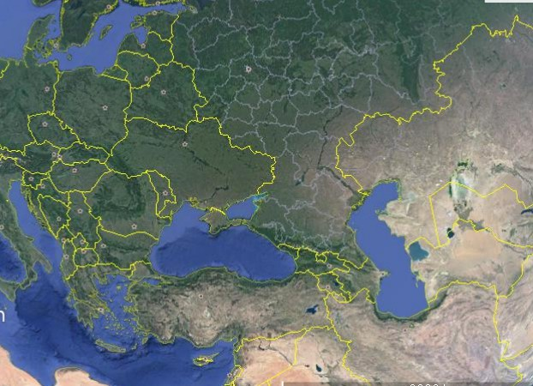
WHERE ARE WE?
RUSSIA
Ryazan
Black Sea
İstanbul
Kars
Ankara
TURKEY
Antalya
Mediterranean

Slide 3
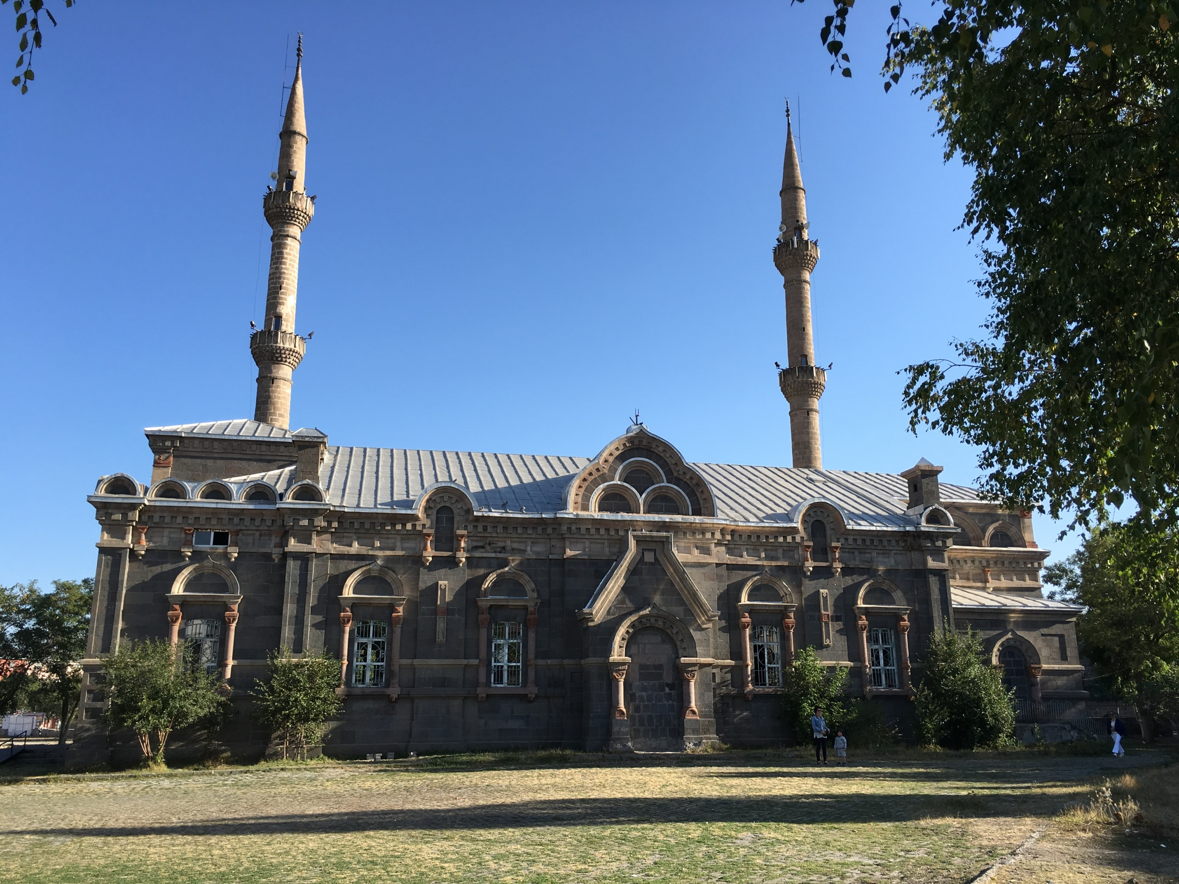
Aleksander Nevsky Catedral was built in 19.yy by russian architecture in Kars .Now The building is using Fethiye Mosque
Turkish and Russian common cultural heritage in Kars

Slide 4
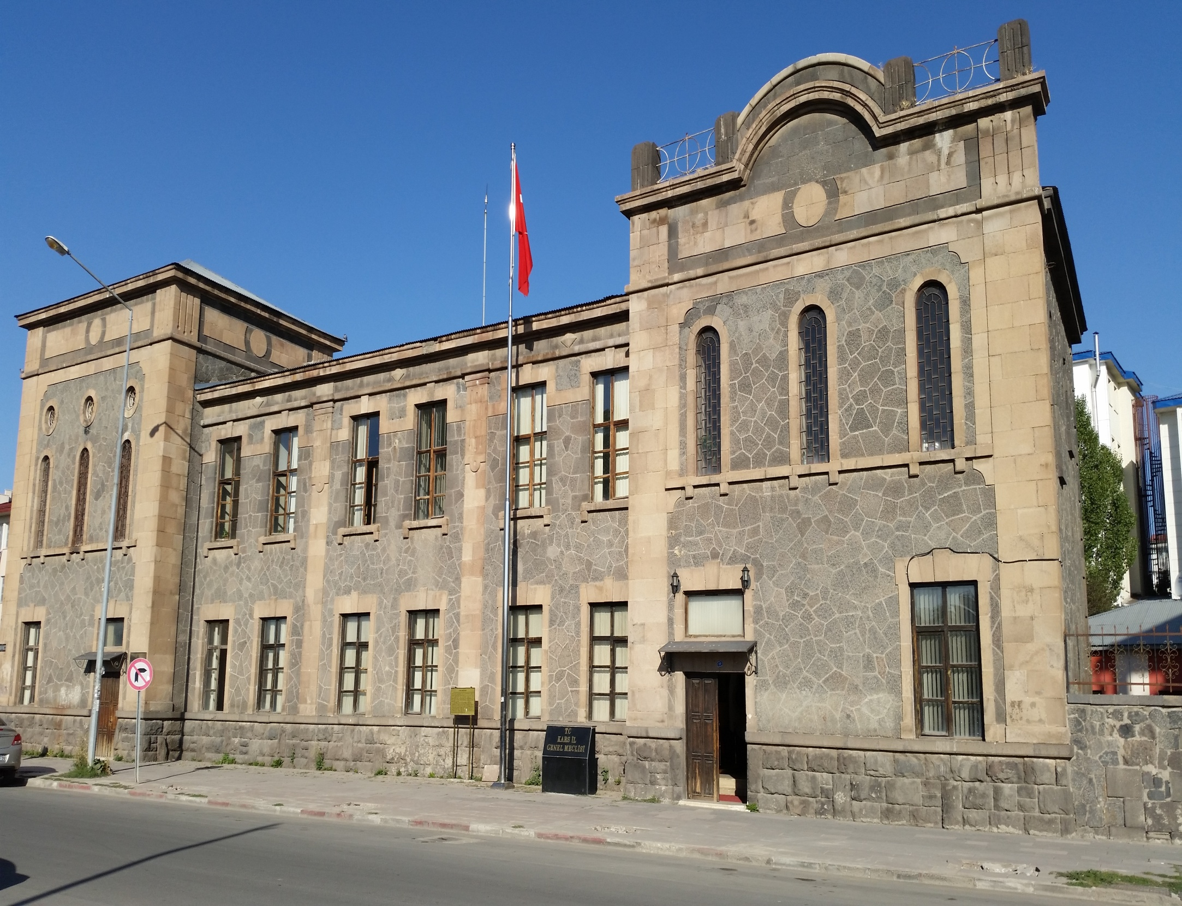
Turkish and Russian common cultural heritage in Kars

Slide 5
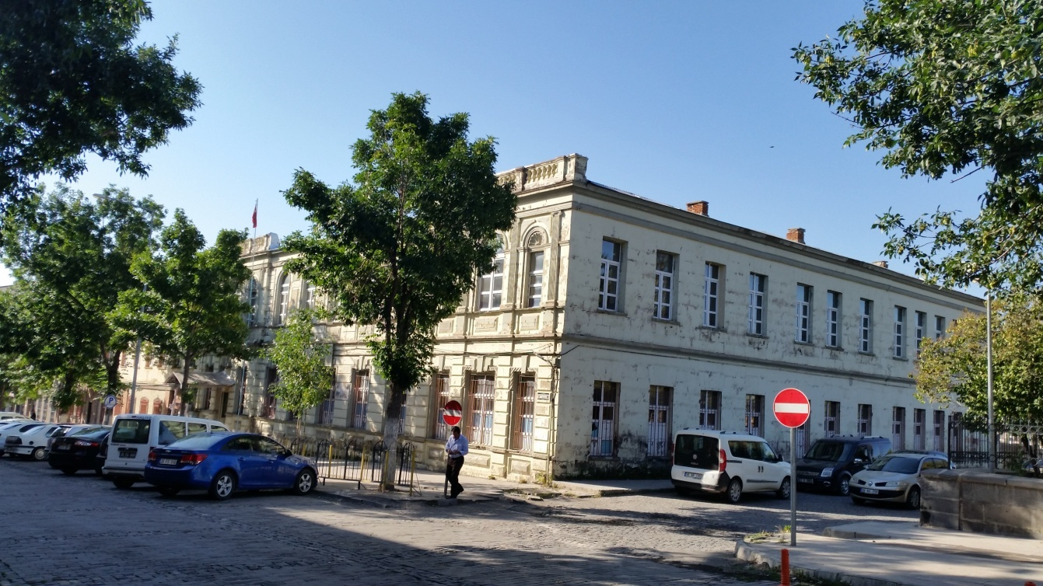
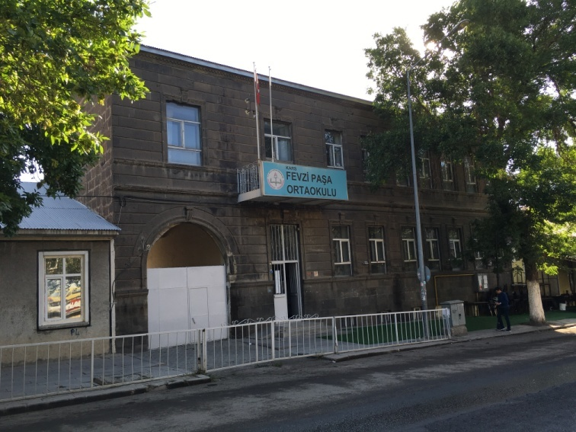
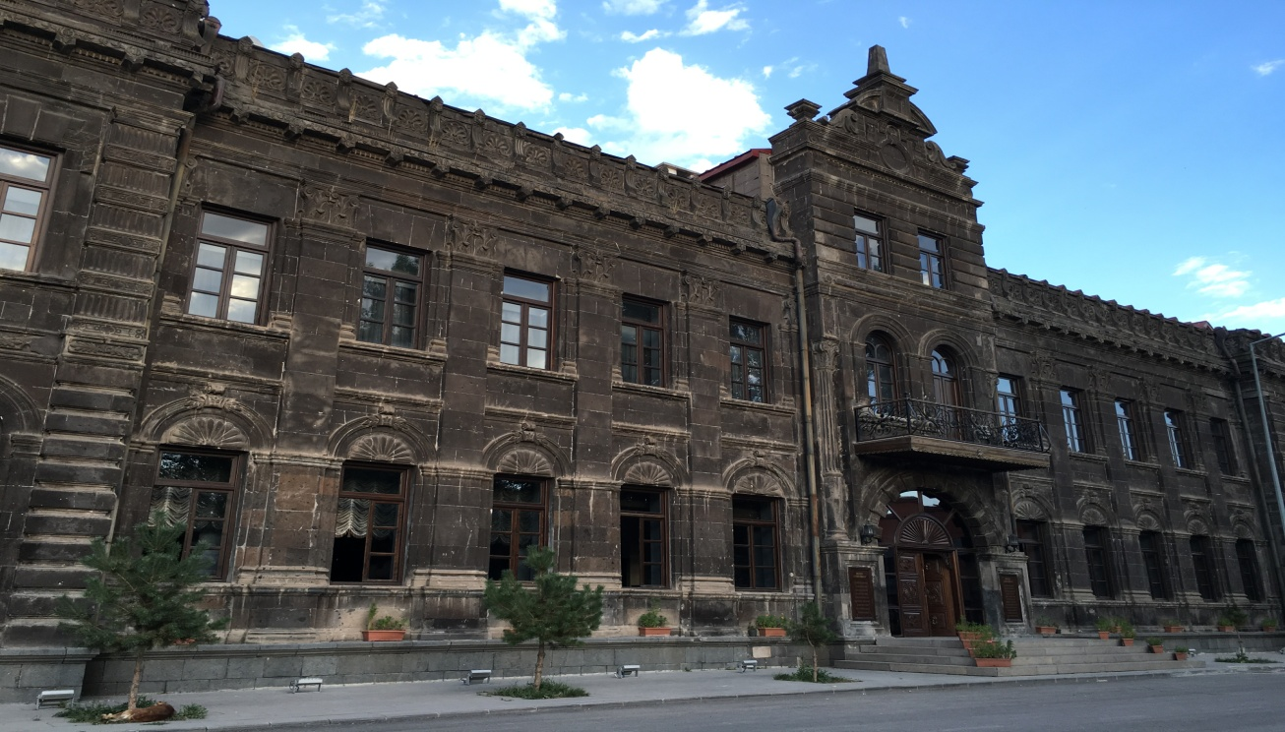
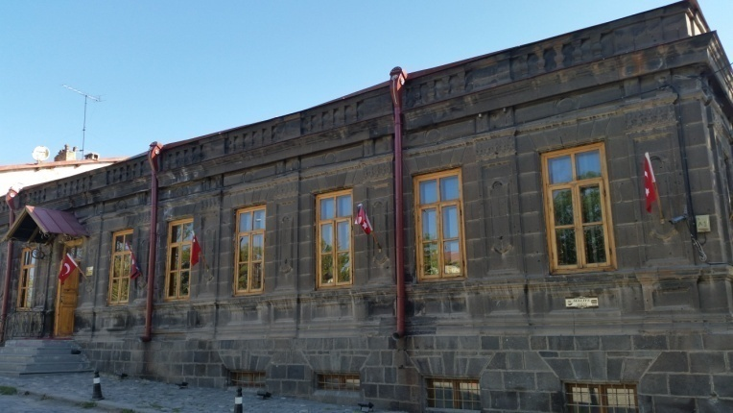
Turkish and Russian common cultural heritage in Kars

Slide 6
Turkish and Russian common cultural heritage in Kars

Slide 7
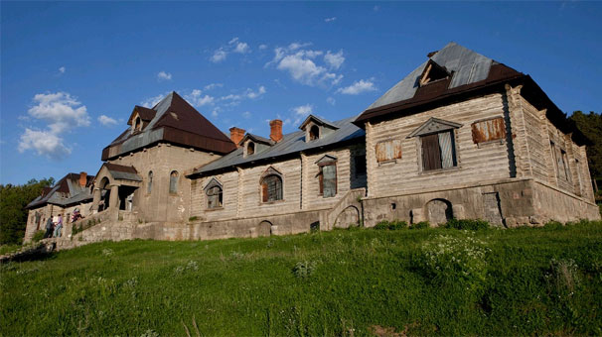
Catherina Pavilion was built on 1896 by 2.Nikola
Turkish and Russian common cultural heritage in Kars

Slide 8
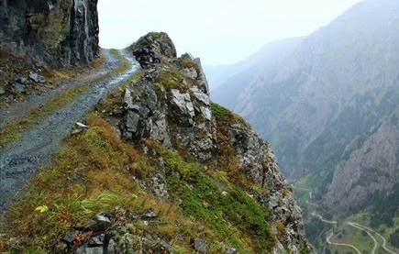
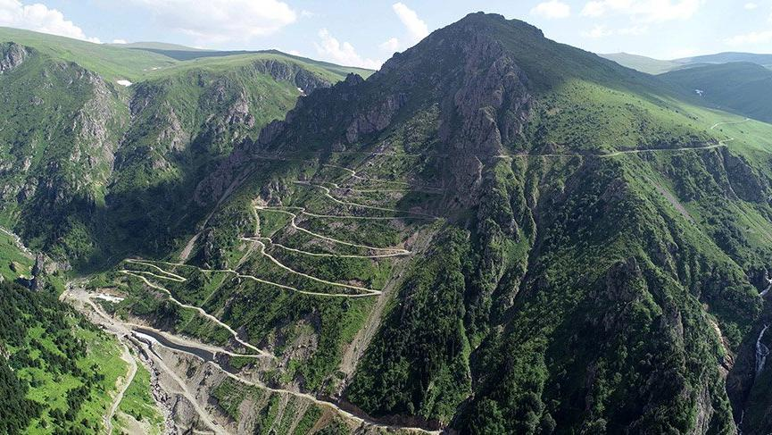
The most dangeorus road in the world was built on 1916 by russian soldier at Bayburt in Turkey
Turkish and Russian common cultural heritage in Kars

Slide 9
WHERE ARE WE?
Ankara is the Capital of Turkey since 1923
RUSSIA
ANKYRA, ANKİRA, ANCYRA, ANCORA, ANKURA, ANKURİA, ANGUR, UNGÜRİ, ENGURU, ENGÜRÜ, ENGÜRİYE, ANGORA, ANGULİ BELDET-İ SELASİL ANGARA and
Ryazan
The oldest names of Ankara
Black Sea
Kars
Ankara
TURKEY
Mediterranean

Slide 10
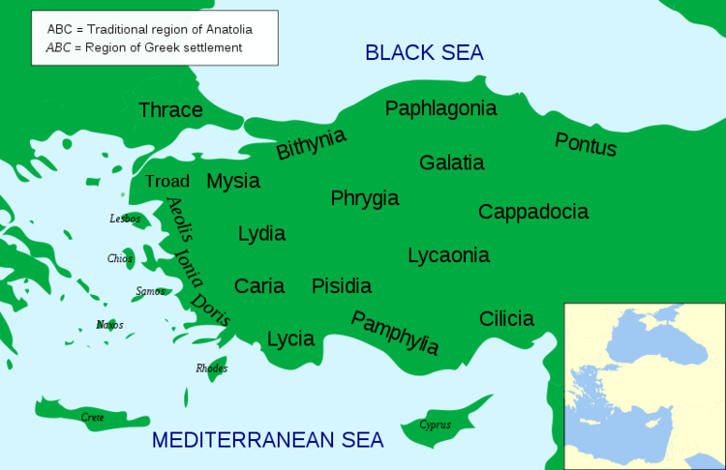
Ankara’s Cronology
Paleolitic (Old Stone) Age (M.Ö.10000) Neolitic Age ( M.Ö.8000-5000) Kalkolitic (Cooper) Age (M.Ö.5000-3000) Old Bronze (Hatti) Age (M.Ö.3000-2000) Bronze Age (Hittite) (M.Ö.2000-700) Phrygian (M.Ö.1200-400) Persians (M.Ö.547) Hellenistic Period (M.Ö.333-30) Galatians(M.Ö.278-M.S.284) Roman Empire (M.Ö.30-M.S.395) Byzantium Empire (M.S.330-1073) Seljuk and Anatolia Seljuks (M.S.1073-1243) Danişmentliler (M.S. 1127) İlhanlılar (M.S.1304-1328) Prcinapality of Eretna (M.S.1328) Republic of Ahi (M.S. 1344)
Ottoman Empire (M.S.1354-1920) Republic of Turkey (1923-
Turkey and Ankara has multicultural structure and cultural heritage of various civilizations

Slide 11
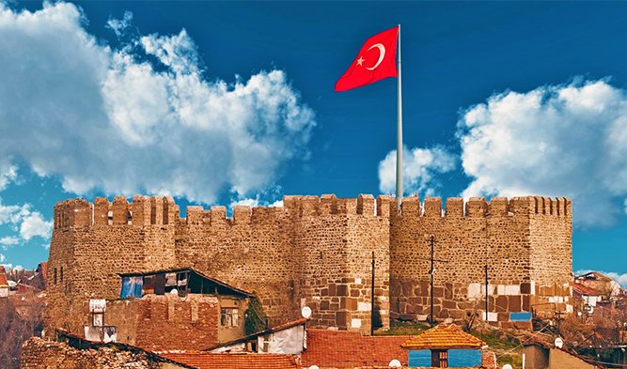
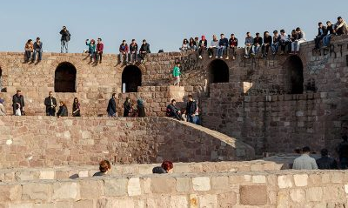
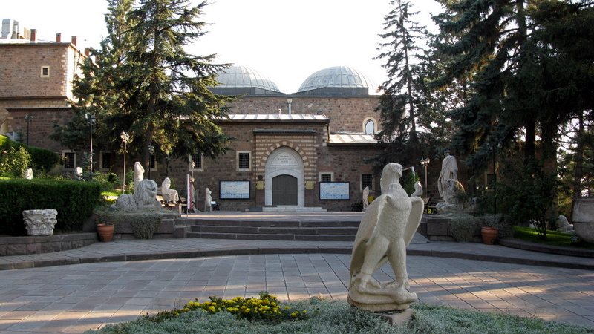
Castel of Ankara
It is not known exactly when Ankara Castel was built.
But it is to be known exist that the early 2nd century BC is in the period of settletments of Galatians

Slide 12
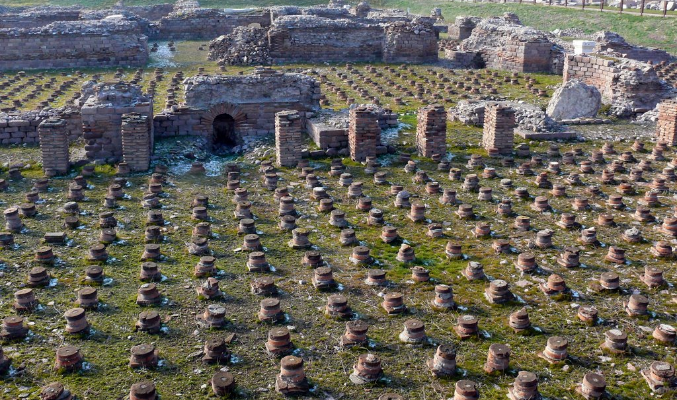
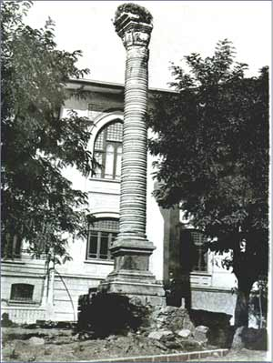
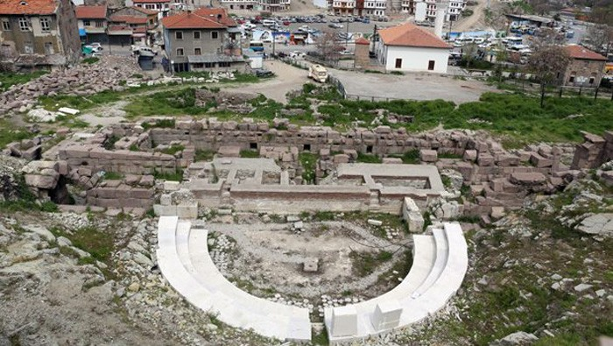
Some of Roman Period cultural heritage in Ankara
Julien
monoliht
Roman Bath in Ankara
Temple of Augustus
Ancient Roman Theatre in Ankara

Slide 13
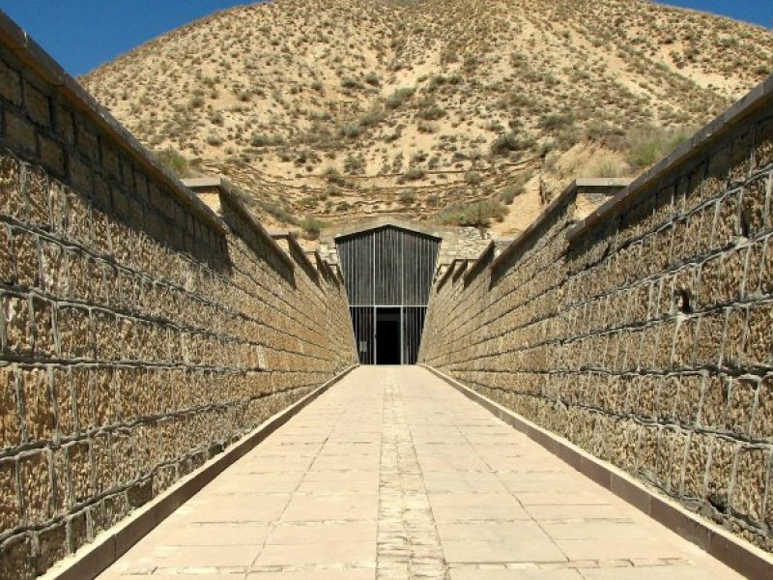
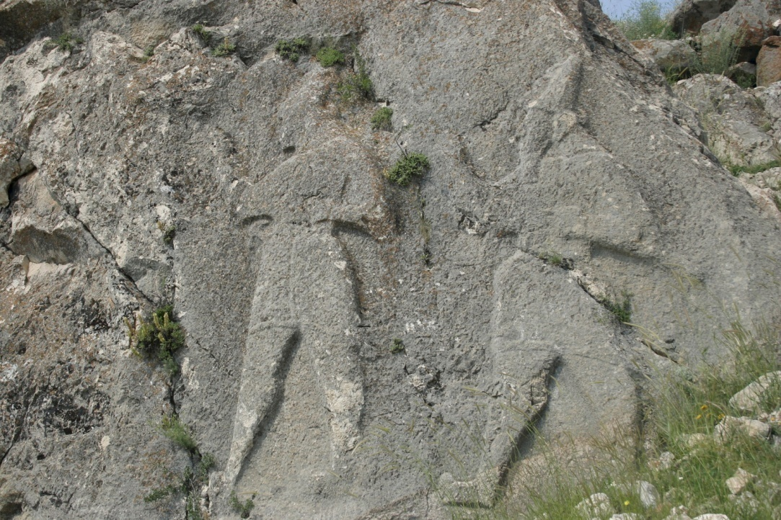
Phrygian Cultural Heritage in near the Ankara
Gordion, BC The Phrygian and Phrygian political and cultural capitals rising along with the collapse of the Hittite Empire in the 12th century.
Hittite Cultural Heritage in Ankara
Gavurkale, which has an important place in Hittite history and Anatolia's history-geography, was first excavated by Von der Osten in 1930 in the direction of Atatürk's request.

Slide 14
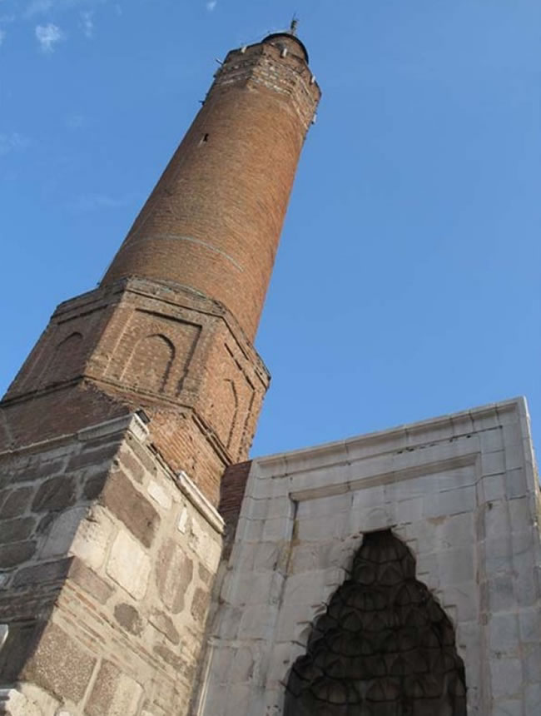
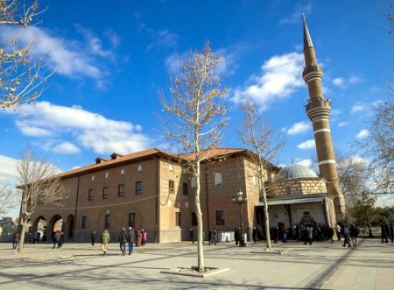
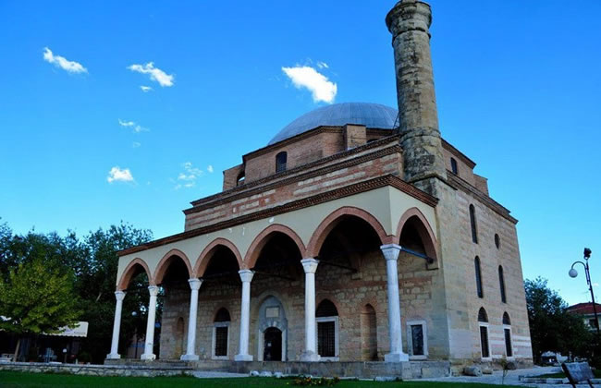
Ottoman Cultural Heritage in Ankara
Hacı Bayram Mosque was built 1427/1428
Kurşunlu Mosque
Arslanhane Mosque

Slide 15
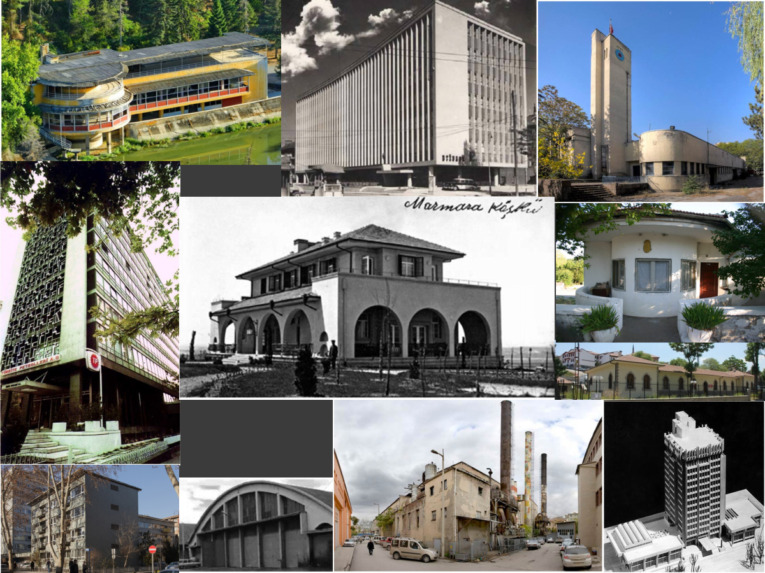
Early Republic period of Modern Architecture
Cultural Heritage in Ankara

Slide 16
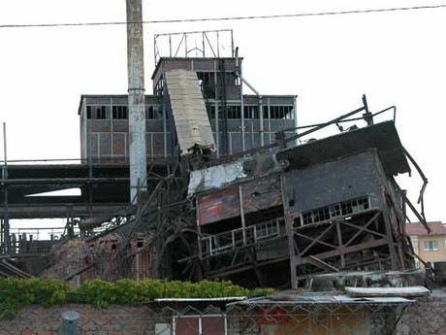
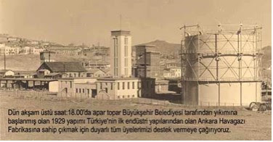
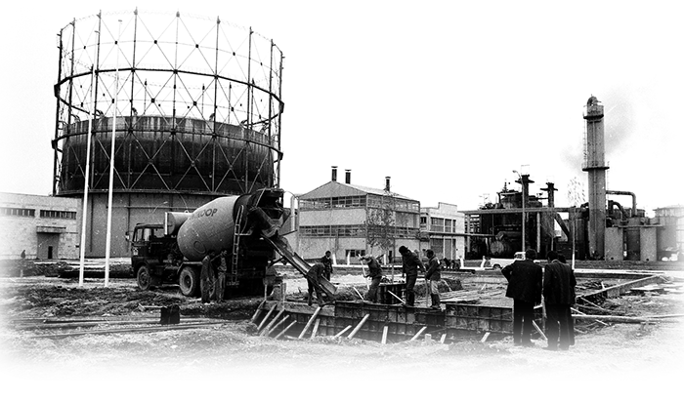
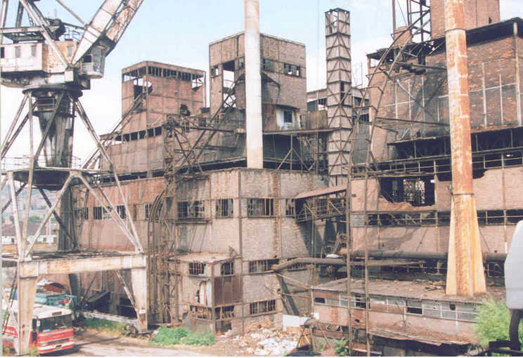
Ankara Electricity and Gasworks Plants / Industrial Heritage
Ankara Electricity and Gasworks Plants was built on 1928-1929
by Architecture Werner Issel
Ankara Electricity and Gasworks Plants demolished between 2006 and 2018

Slide 17
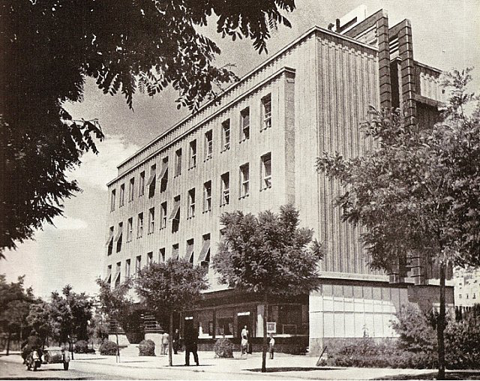
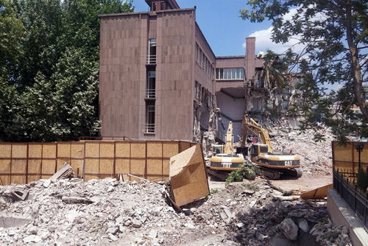
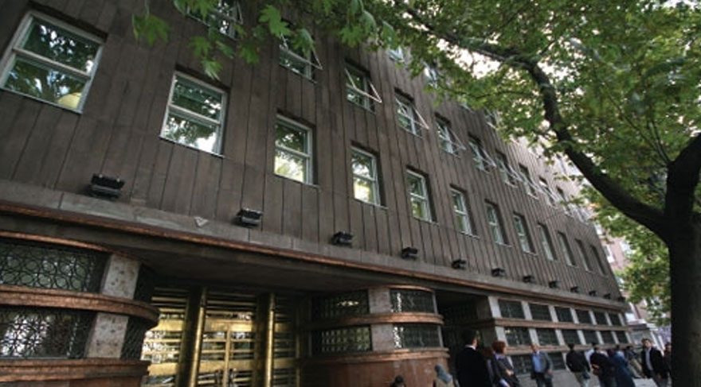
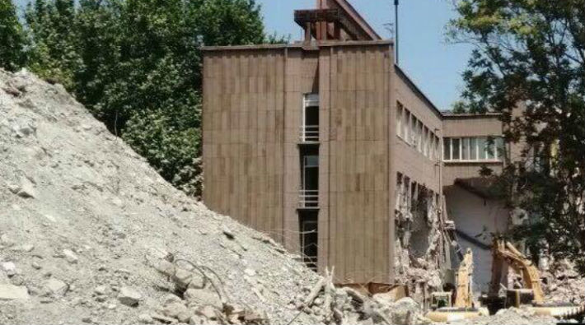
Ankara Municipality Bank Building / Cultural Heritage
Municipality Bank was built on 1933 -
by Architecture Seyfi Arkan
Municipality Bank Building demolished on 2017

Slide 18
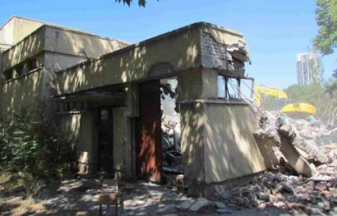
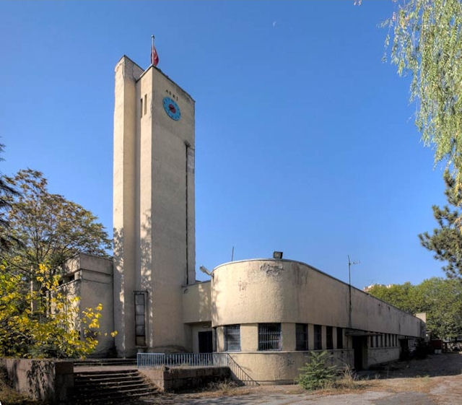
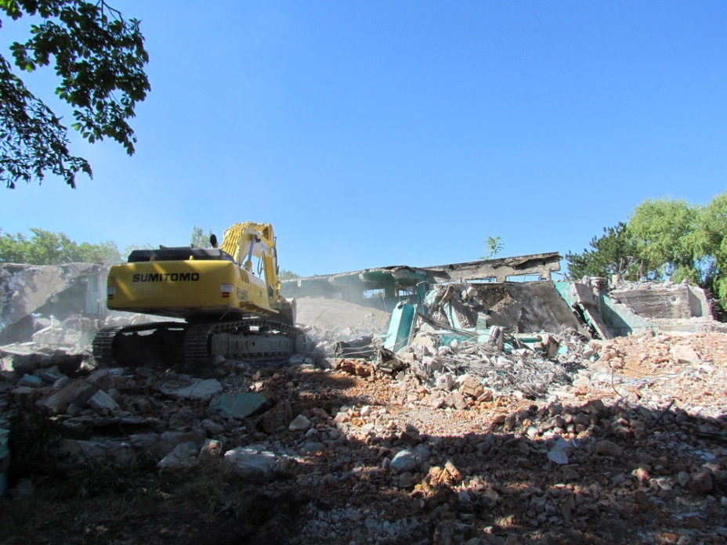
Ankara Water Filter Building / Cultural Heritage
Ankara Water Filter Building was built on 1936 by Hochtief Company
Ankara Water Filter Building demolished on 2013

Slide 19
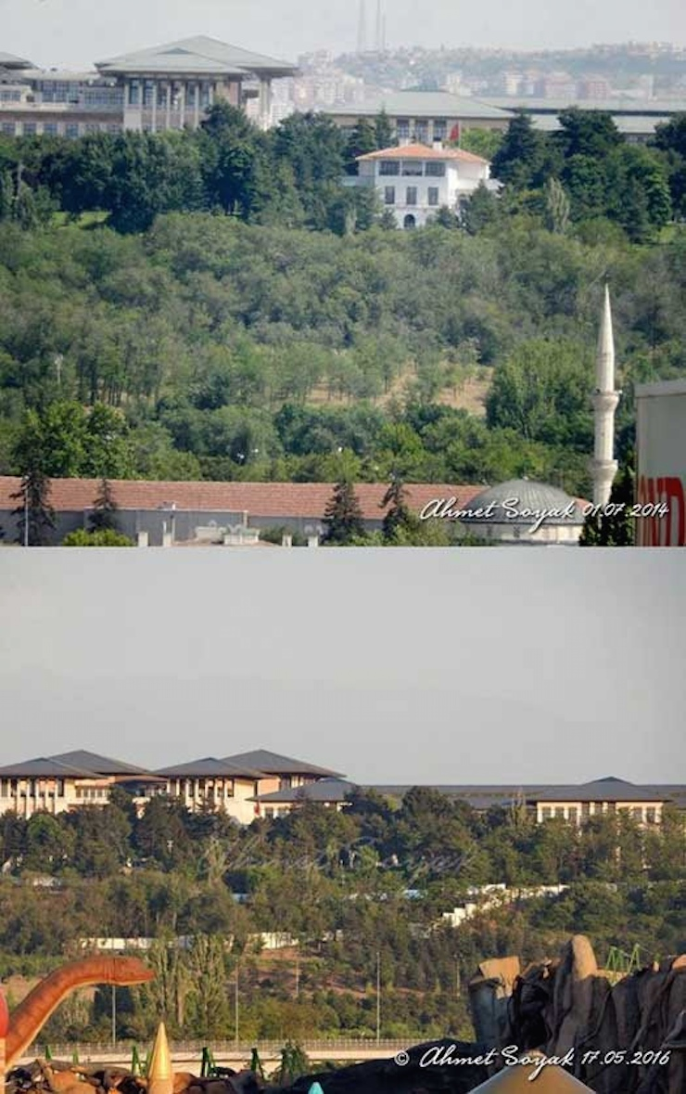
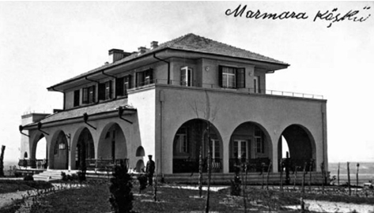
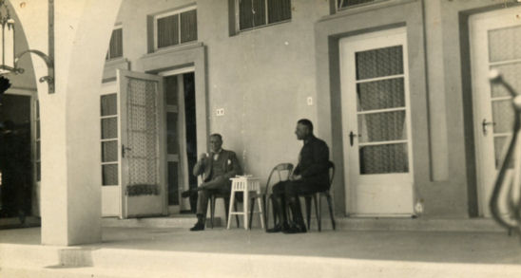
Ankara Atatürk's Marmara Pavilion/ Cultural Heritage
Marmara Pavillon Building was built on 1928 by Switzerland Architect Ernest Eğli
Marmara Pavillion demolished on 2016

Slide 20
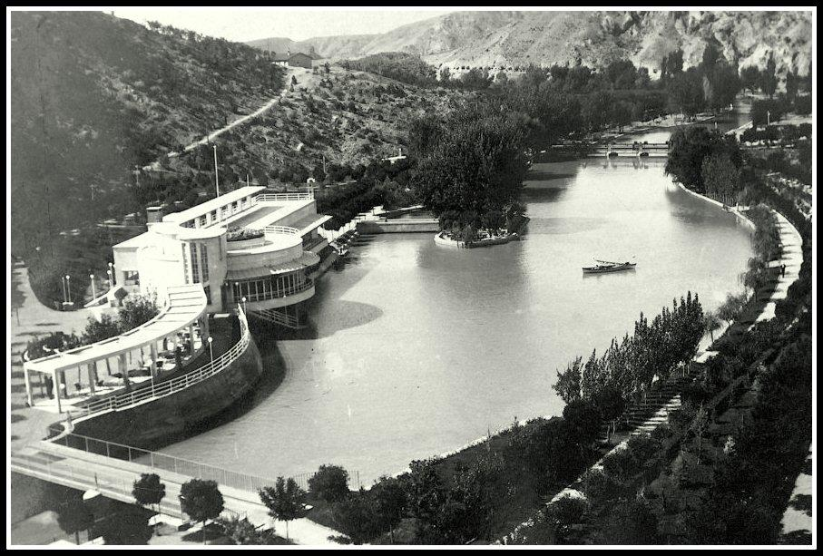
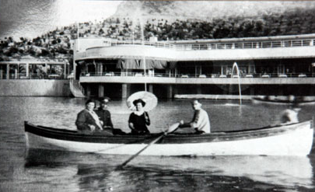
Ankara Dam Casino / Cultural Heritage
Dam Casino was built on 1938 by France Architect Theo Leveau
Dam Casino demolished on 2016

Slide 21
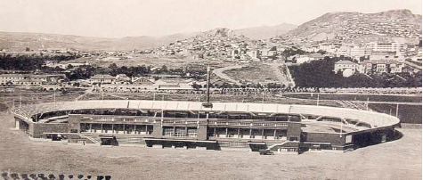
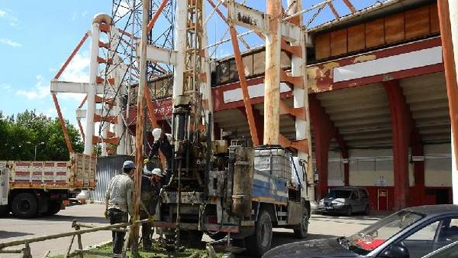
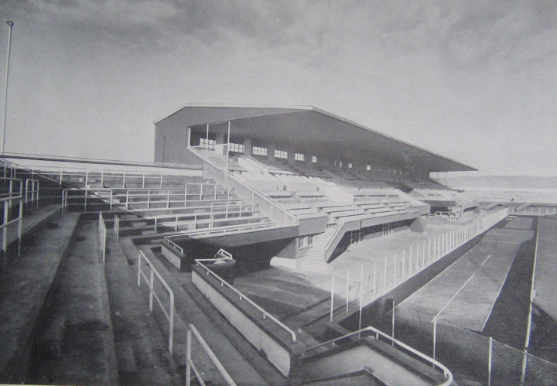
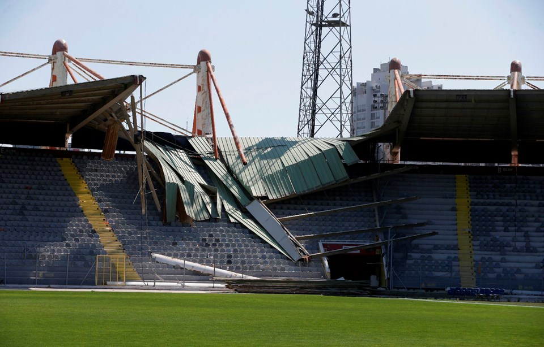
May 19 Stadium / Cultural Heritage
May 19 Stadium was built on 1934 by Italian Architect Paolo Vietti-Violi
May 19 Stadium was started demolishing when we came this congress

Slide 22
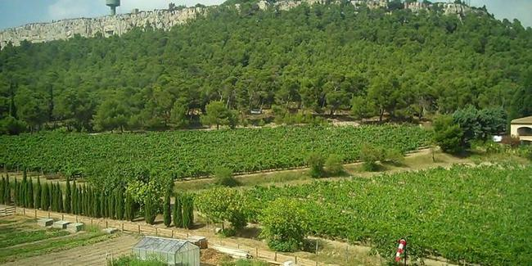
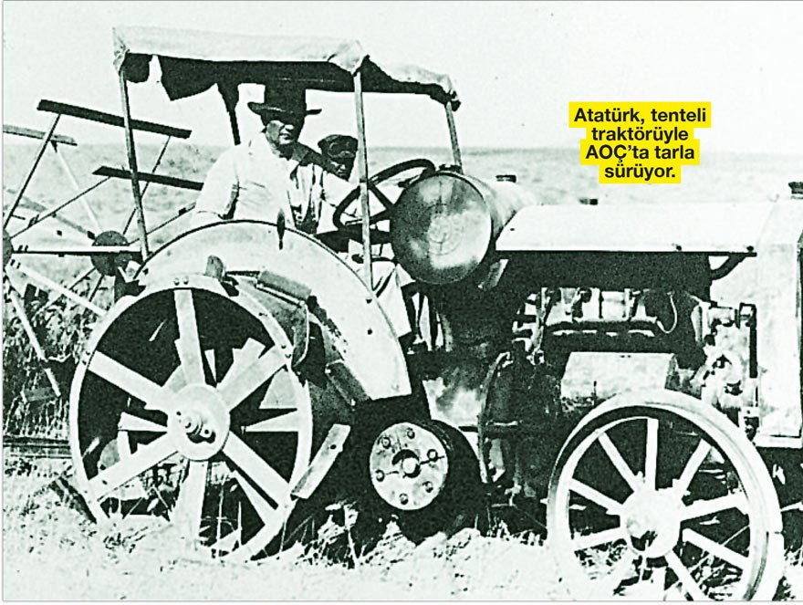
Atatürk Forest Farm(AOÇ) / Historical and Natural Heritage
Atatürk's in Atatürk Forest Farm
Atatürk Forest Farm established with the leadership of Mustafa Kemal Atatürk,the founder of the Turkish Republic in 1925.Atatürk Forest Farm which was plaanned as alarge green area in the periphery of the capital, realaized agriculture and human relationship with example giving projects and which now has an area of 33 500 000 hectares with meeting points caontaining social recreation areas was taken under conservation 1st degree Natural Site Area and Historical Sit Area. İn the Atatürk Forest farm which has an area equivalent with 14 Hydeparks,10 central parks and 920 Geziparks,a process of great damage and destruction is experinced between 2012-2018.Forty percent (%40) of the AOÇ area is opened to construction with various allocations,usages and proejcts that are contradictory with its aim since its foundation

Slide 23
Atatürk Forest Farm(AOÇ) / Historical and Natural Heritage
Turkish Government construction of a building was started without consulting with any one and by cutting thousands of tree in AOÇ .Despite all scientific warnings and legal court decisions about the damages which the building with a total construction area of 600.000 square meters and over 2000 rooms, on the area and the urban life, the building reached completion.
Although various decisions of annulment were taken in the legal cases started , President Mr. Recep Tayyip Erdoğan ordered the Consturction to be continued.The Construction activity was only completed under the protection of the security forces despite the public opinion pressures and legal court decisions . Attitude of then Erdoğan who stated that the legal court decisions will not be applied, contradicting with the universal legal principles was finally taken to the constitutional court and Europan Human Rights Court.

Slide 24
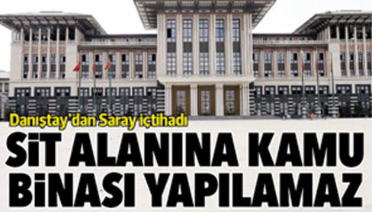
Atatürk Forest Farm(AOÇ) / Historical and Natural Heritage
We wrote the book which is the name of the "Kaçak Saray" of this Lawlessness about Historical and Natural Heritage Area in Atatürk Forest Farm
This Building is using presidental palace. But we says illegal palace "Kaçak Saray". 105 cases are continue against the illegal palace by the Chamber of Architects of Ankara Branch

Slide 25
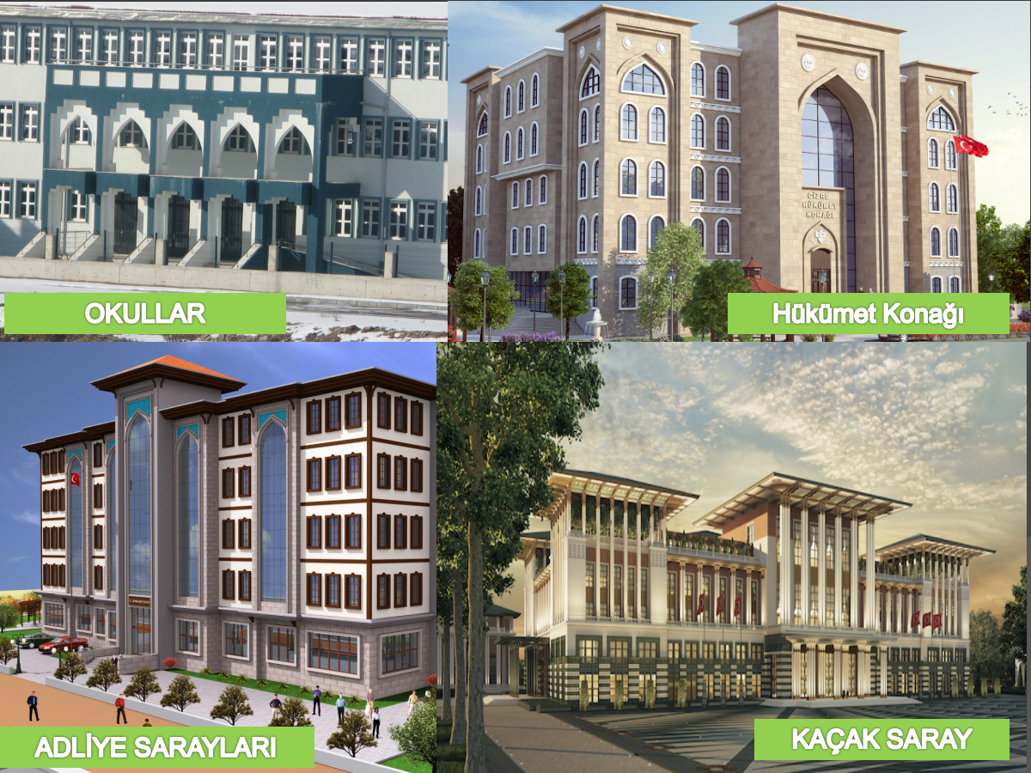
New Islamic arcihtecture in Turkey
School
Goverment House
Justice Palace
President Palace the other name illegal Palace

Slide 26
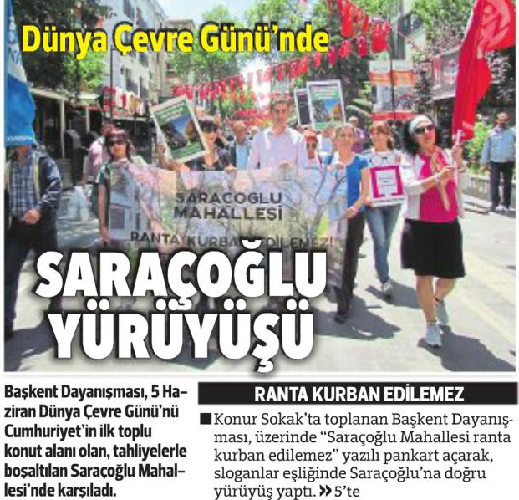
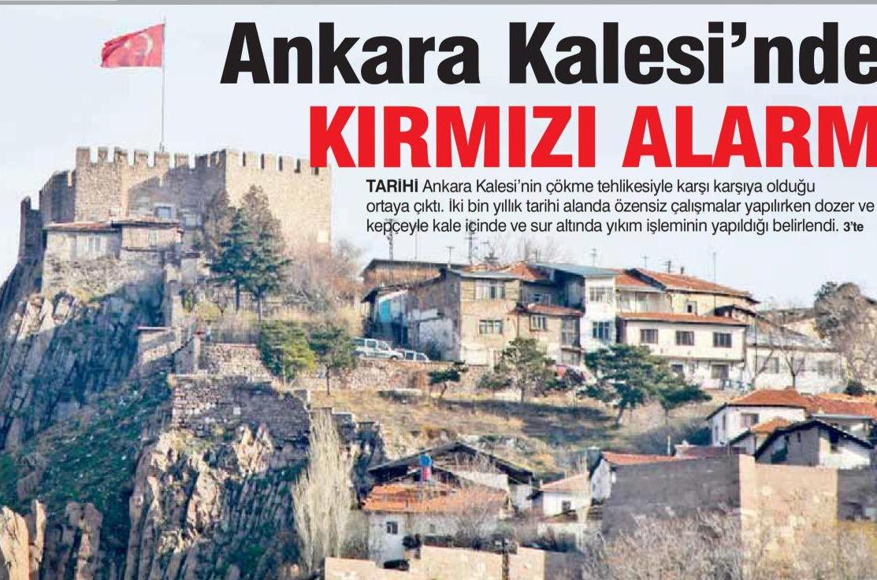
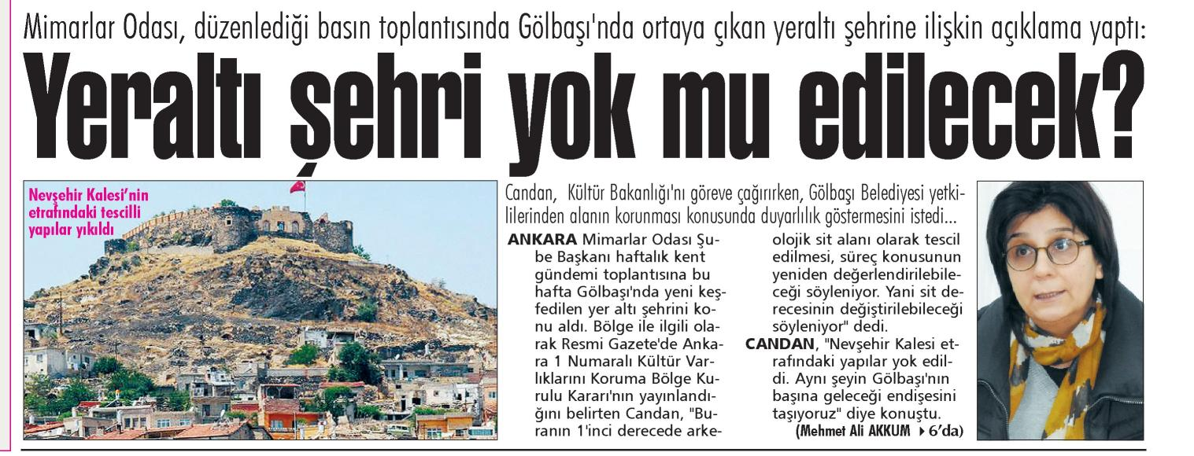
What are we doing for protection of Cultural Heritage in Ankara in Turkey as a Chamber of Architecture of Ankara Branch
We are making press meeting to inform the public about cultural , natural and historical heritage,
We organize national and international scientific meetings and symposiums
We prepare reports for the protection of cultural heritage,
We are making meetings in the neighborhood with the people for cultural heritage awareness,

Slide 27
What are we doing for protection of Cultural Heritage in Ankara in Turkey as a Chamber of Architecture of Ankara Branch
We have been studying children for awareness to cultural heritage since 2002 at school, preschool, and high scool and outside school
We open “city dream project competitions” for the to re-functional of cultural heritage.
We organize exhibition of Cultural Heritage every where, street, market, metro,museum exct.

Slide 28
What are we doing for protection of Cultural Heritage in Ankara in Turkey as a Chamber of Architecture of Ankara Branch
We are working workshop with University and architectural students about cultural heritage
We use 5 senses for Cultural Heritage awareness of Cultural Heritage every where

Slide 29
Cultural Heritage is memory.İf you dont have the memory, you can not not to be your future.
As the Ankara Branch of the Chamber of Architects, we continue to struggle to develop the protection of cultural, natural and historical heritage and create awareness in the community.
Благодарю за внимание!
Thanks…Teşekkürler

