Slide 1
СОХРАНЕНИЕ АРХИТЕКТУРНОГО НАСЛЕДИЯ В ТУРЦИИ ARCHITECTURAL HERITAGE CONSERVATION IN TURKEY TÜRKİYE’DE MİMARİ MİRASI KORUMA ÇALIŞMALARI
N.CANSEN KILIÇÇÖTE
Rest.Uzm.Y.Mimar
Ryazan - Ağustos 2018

Slide 2
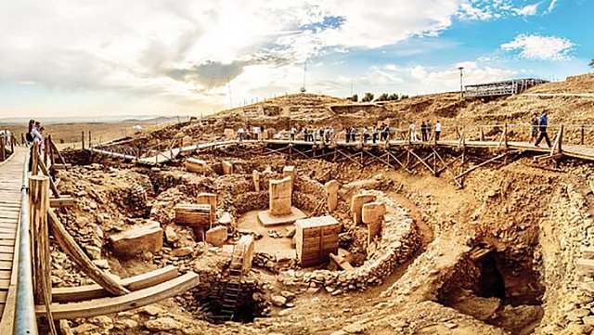
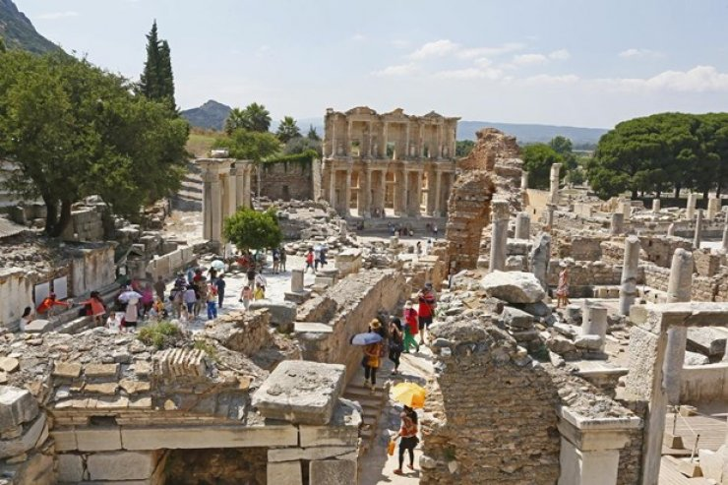
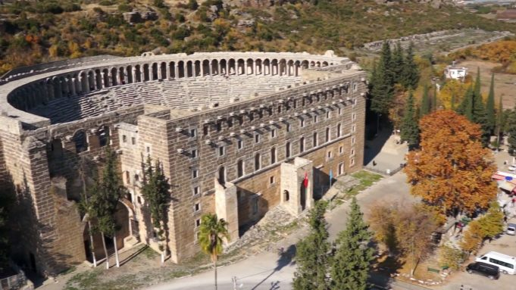
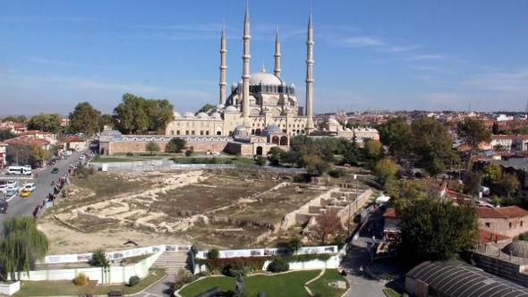
СОХРАНЕНИЕ АРХИТЕКТУРНОГО НАСЛЕДИЯ В ТУРЦИИ ARCHITECTURAL HERITAGE CONSERVATION IN TURKEY TÜRKİYE’DE MİMARİ MİRASI KORUMA ÇALIŞMALARI
GÖBEKLİTEPE – 10.000 BC
EFES – 3.000 BC
ASPENDOS – 200 AD
SELİMİYE – 1575 AD

Slide 3
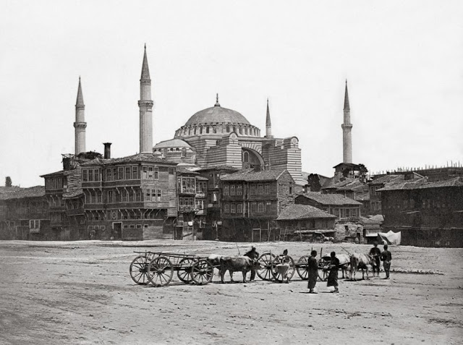
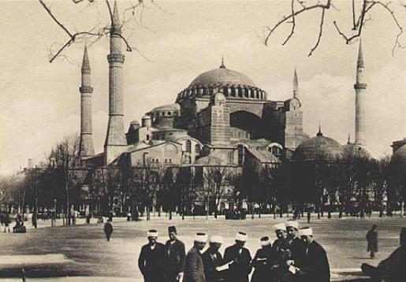
СОХРАНЕНИЕ АРХИТЕКТУРНОГО НАСЛЕДИЯ В ТУРЦИИ ARCHITECTURAL HERITAGE CONSERVATION IN TURKEY TÜRKİYE’DE MİMARİ MİRASI KORUMA ÇALIŞMALARI
Aya Sofya Camisi Çevresinin Açılması-19.yy
Environmental Organizations around Hagia Sophia in İstanbul-19th century

Slide 4
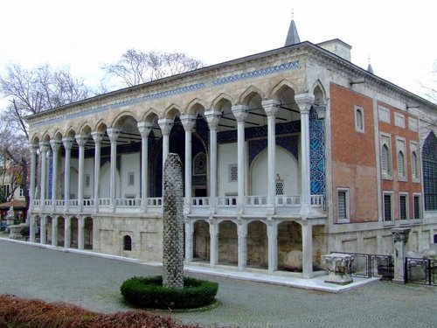
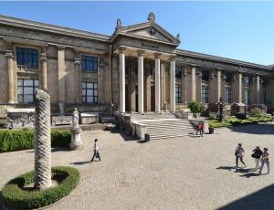
СОХРАНЕНИЕ АРХИТЕКТУРНОГО НАСЛЕДИЯ В ТУРЦИИ ARCHITECTURAL HERITAGE CONSERVATION IN TURKEY TÜRKİYE’DE MİMARİ MİRASI KORUMA ÇALIŞMALARI
Çinili Köşk, İstanbul
İstanbul Arkeoloji Müzesi
Archaeological Musem in İstanbul

Slide 5
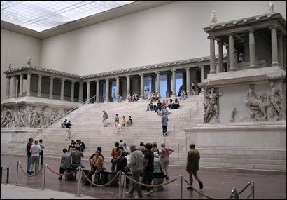
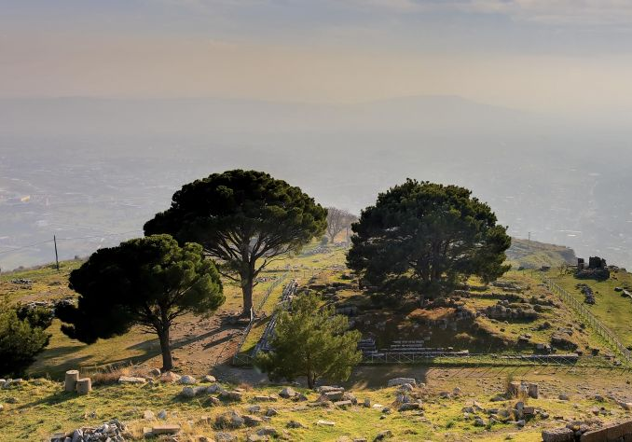
СОХРАНЕНИЕ АРХИТЕКТУРНОГО НАСЛЕДИЯ В ТУРЦИИ ARCHITECTURAL HERITAGE CONSERVATION IN TURKEY TÜRKİYE’DE MİMARİ MİRASI KORUMA ÇALIŞMALARI
Bergama Zeus Altarı Kalıntıları
Remains of Zeus Altar in Pergamon
Bergama Zeus Altarı-Berlin Müzesi
Pergamon Zeus Altar in Berlin Museum

Slide 6
СОХРАНЕНИЕ АРХИТЕКТУРНОГО НАСЛЕДИЯ В ТУРЦИИ ARCHITECTURAL HERITAGE CONSERVATION IN TURKEY TÜRKİYE’DE MİMARİ MİRASI KORUMA ÇALIŞMALARI
Kültür ve Turizm Bakanı
Minister of Culture and Tourism
Türk İşbirliği ve Koordinasyon Ajansı
Turkish Cooperation and Coordination Agency
Vakıflar Genel Müdürlüğü
General Directorate of Pious Foundations
Bakan Yardımcısı
Deputy Minister
Kültür Varlıkları ve Müzeler Genel Müdürlüğü
General Directorate of Cultural Assets and Museums
Koruma Kurulları
Preservation Boards
Rölöve ve Anıtlar Md.
Monuments Directorate
Laboratuvarlar
Laboratories
Müzeler
Museums

Slide 7
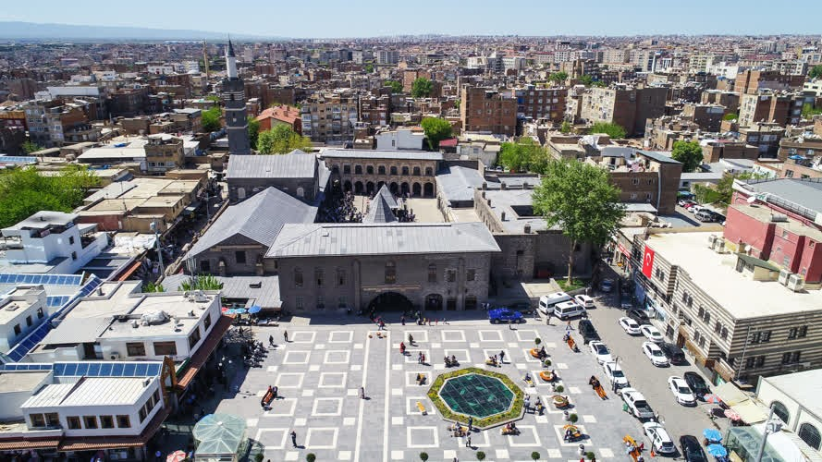
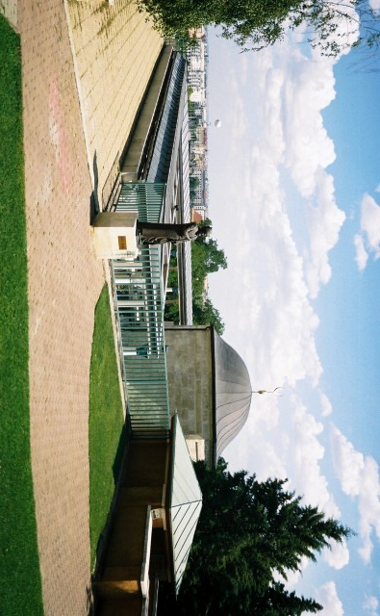
СОХРАНЕНИЕ АРХИТЕКТУРНОГО НАСЛЕДИЯ В ТУРЦИИ ARCHITECTURAL HERITAGE CONSERVATION IN TURKEY TÜRKİYE’DE MİMARİ MİRASI KORUMA ÇALIŞMALARI
- Vakıflar Genel Müdürlüğü/General Directorate of Pious Foundations
Gül Baba Thomb- Budapest
Diyarbakır Ulu Camisi

Slide 8
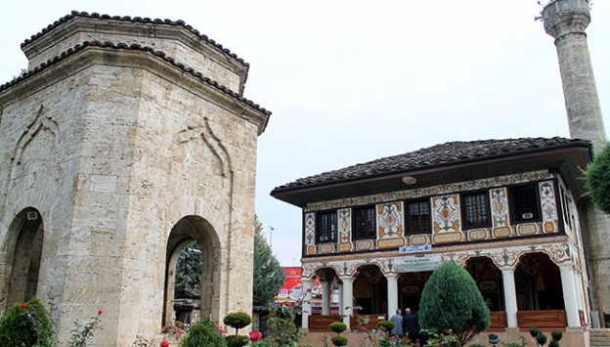
СОХРАНЕНИЕ АРХИТЕКТУРНОГО НАСЛЕДИЯ В ТУРЦИИ ARCHITECTURAL HERITAGE CONSERVATION IN TURKEY TÜRKİYE’DE MİMARİ MİRASI KORUMA ÇALIŞMALARI
- Türk İşbirliği ve Koordinasyon Ajansı/Turkish Cooperation and Coordination Agency
Nazire Camisi-Arnavutluk/Albania

Slide 9
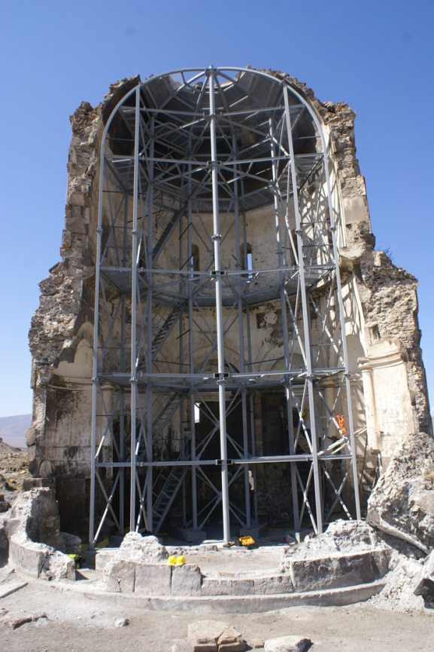
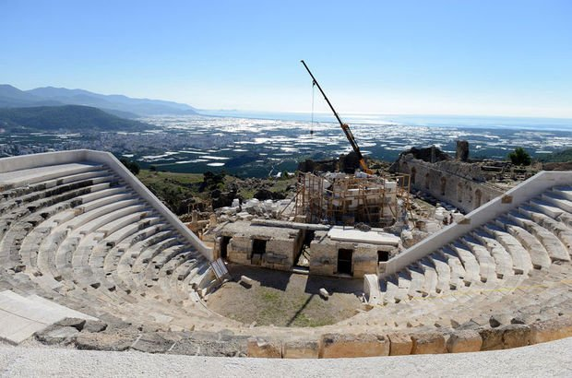
СОХРАНЕНИЕ АРХИТЕКТУРНОГО НАСЛЕДИЯ В ТУРЦИИ ARCHITECTURAL HERITAGE CONSERVATION IN TURKEY TÜRKİYE’DE MİMARİ MİRASI KORUMA ÇALIŞMALARI
- Kültür Varlıkları ve Müzeler Genel Müdürlüğü/General Directorate of Cultural Assets and Museums
Ani-Kars
Rhodiapolis-Antalya

Slide 10
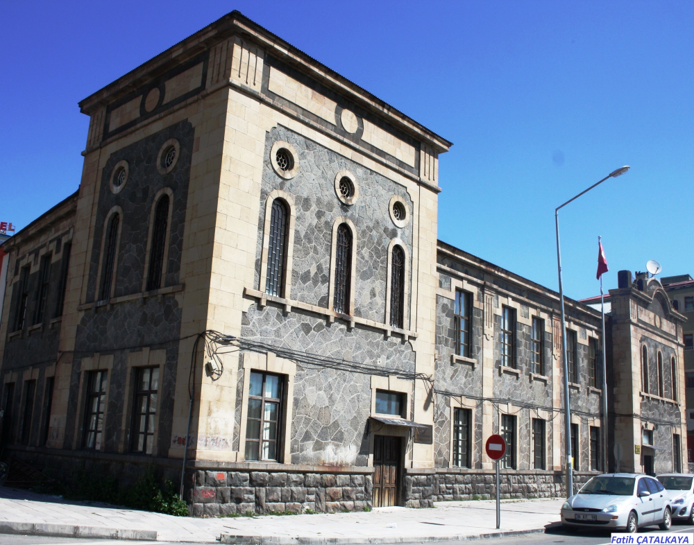
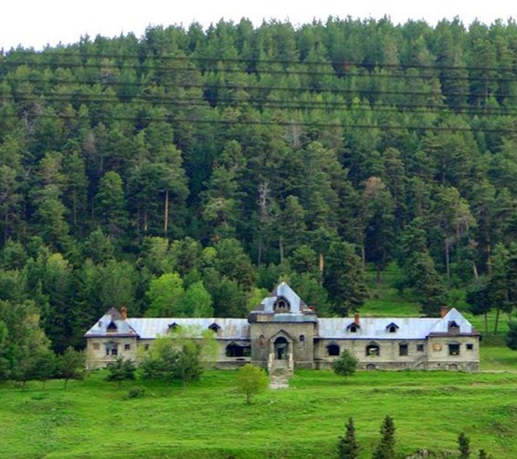
СОХРАНЕНИЕ АРХИТЕКТУРНОГО НАСЛЕДИЯ В ТУРЦИИ ARCHITECTURAL HERITAGE CONSERVATION IN TURKEY TÜRKİYE’DE MİMARİ MİRASI KORUMA ÇALIŞMALARI
- Kültür Varlıkları ve Müzeler Genel Müdürlüğü/General Directorate of Cultural Assets and Museums
Kars

Slide 11
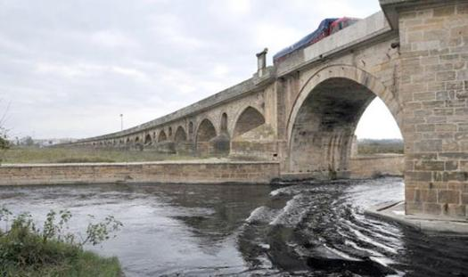
СОХРАНЕНИЕ АРХИТЕКТУРНОГО НАСЛЕДИЯ В ТУРЦИИ ARCHITECTURAL HERITAGE CONSERVATION IN TURKEY TÜRKİYE’DE MİMARİ MİRASI KORUMA ÇALIŞMALARI
-Karayolları Genel Müdürlüğü / General Directorate of Highways
Uzunköprü-Edirne

Slide 12
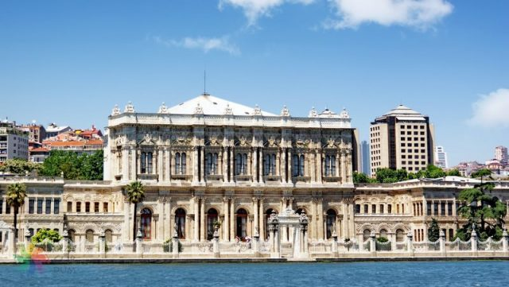
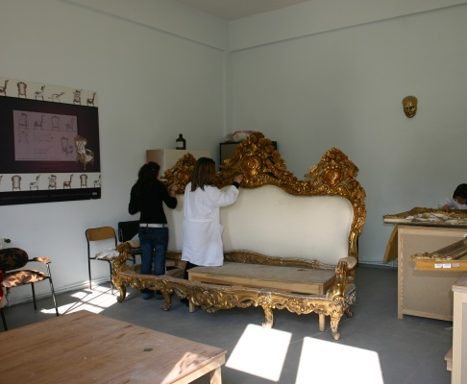
СОХРАНЕНИЕ АРХИТЕКТУРНОГО НАСЛЕДИЯ В ТУРЦИИ ARCHITECTURAL HERITAGE CONSERVATION IN TURKEY TÜRKİYE’DE MİMARİ MİRASI KORUMA ÇALIŞMALARI
- Milli Saraylar İdaresi Başkanlığı/ Presidential Directorate of National Palaces
Dolmabahçe Palace, İstanbul
Restoration Atellier

Slide 13
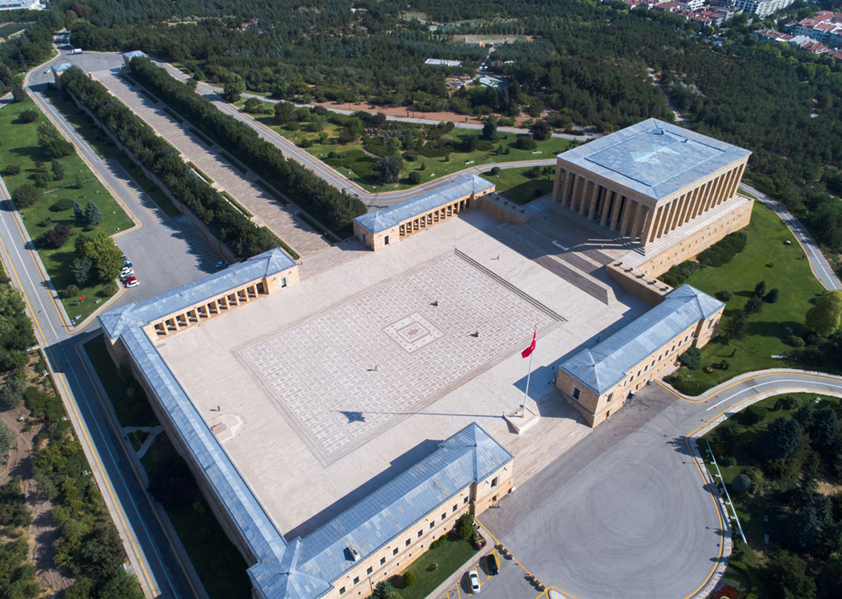
СОХРАНЕНИЕ АРХИТЕКТУРНОГО НАСЛЕДИЯ В ТУРЦИИ ARCHITECTURAL HERITAGE CONSERVATION IN TURKEY TÜRKİYE’DE MİMARİ MİRASI KORUMA ÇALIŞMALARI
- Milli Savunma Bakanlığı/ Ministry of National Defense
Anıtkabir, Ankara

Slide 14
СОХРАНЕНИЕ АРХИТЕКТУРНОГО НАСЛЕДИЯ В ТУРЦИИ ARCHITECTURAL HERITAGE CONSERVATION IN TURKEY TÜRKİYE’DE MİMARİ MİRASI KORUMA ÇALIŞMALARI
- Sivil Toplum Kuruluşları/ Non Governmental Organizations
The Foundation for the Conservation of Turkey's Monuments, Environment and Tourism Assets
The History Foundation
Historic Towns Association
Conservation and Restoration Specialists Association

Slide 15
СОХРАНЕНИЕ АРХИТЕКТУРНОГО НАСЛЕДИЯ В ТУРЦИИ ARCHITECTURAL HERITAGE CONSERVATION IN TURKEY TÜRKİYE’DE MİMARİ MİRASI KORUMA ÇALIŞMALARI
Definitions in Law on the Conservation of Cultural and Natural Property (No.2863)
City = Urban Site
Remains of a City = Archaeological Site
Natural values = Natural Site
+
Urban Archaeological Site
Complex Site
Rural Site
Cultural Landscape
Conservation Tools
Conservation Plan
Landscaping Project
Street Rehabilitation Project

Slide 16
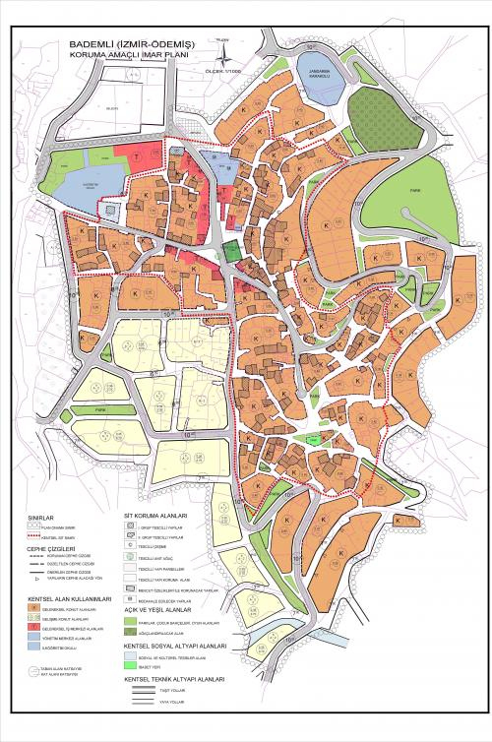
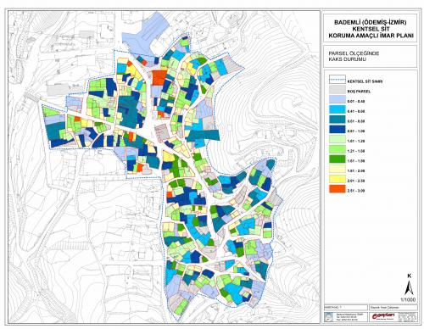
СОХРАНЕНИЕ АРХИТЕКТУРНОГО НАСЛЕДИЯ В ТУРЦИИ ARCHITECTURAL HERITAGE CONSERVATION IN TURKEY TÜRKİYE’DE MİMARİ MİRASI KORUMA ÇALIŞMALARI
CONSERVATION PLAN

Slide 17
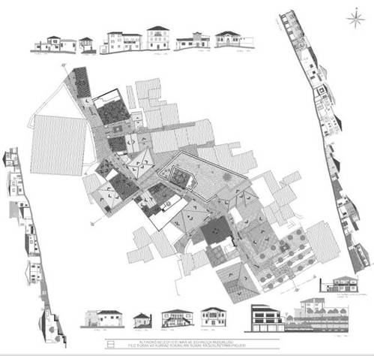
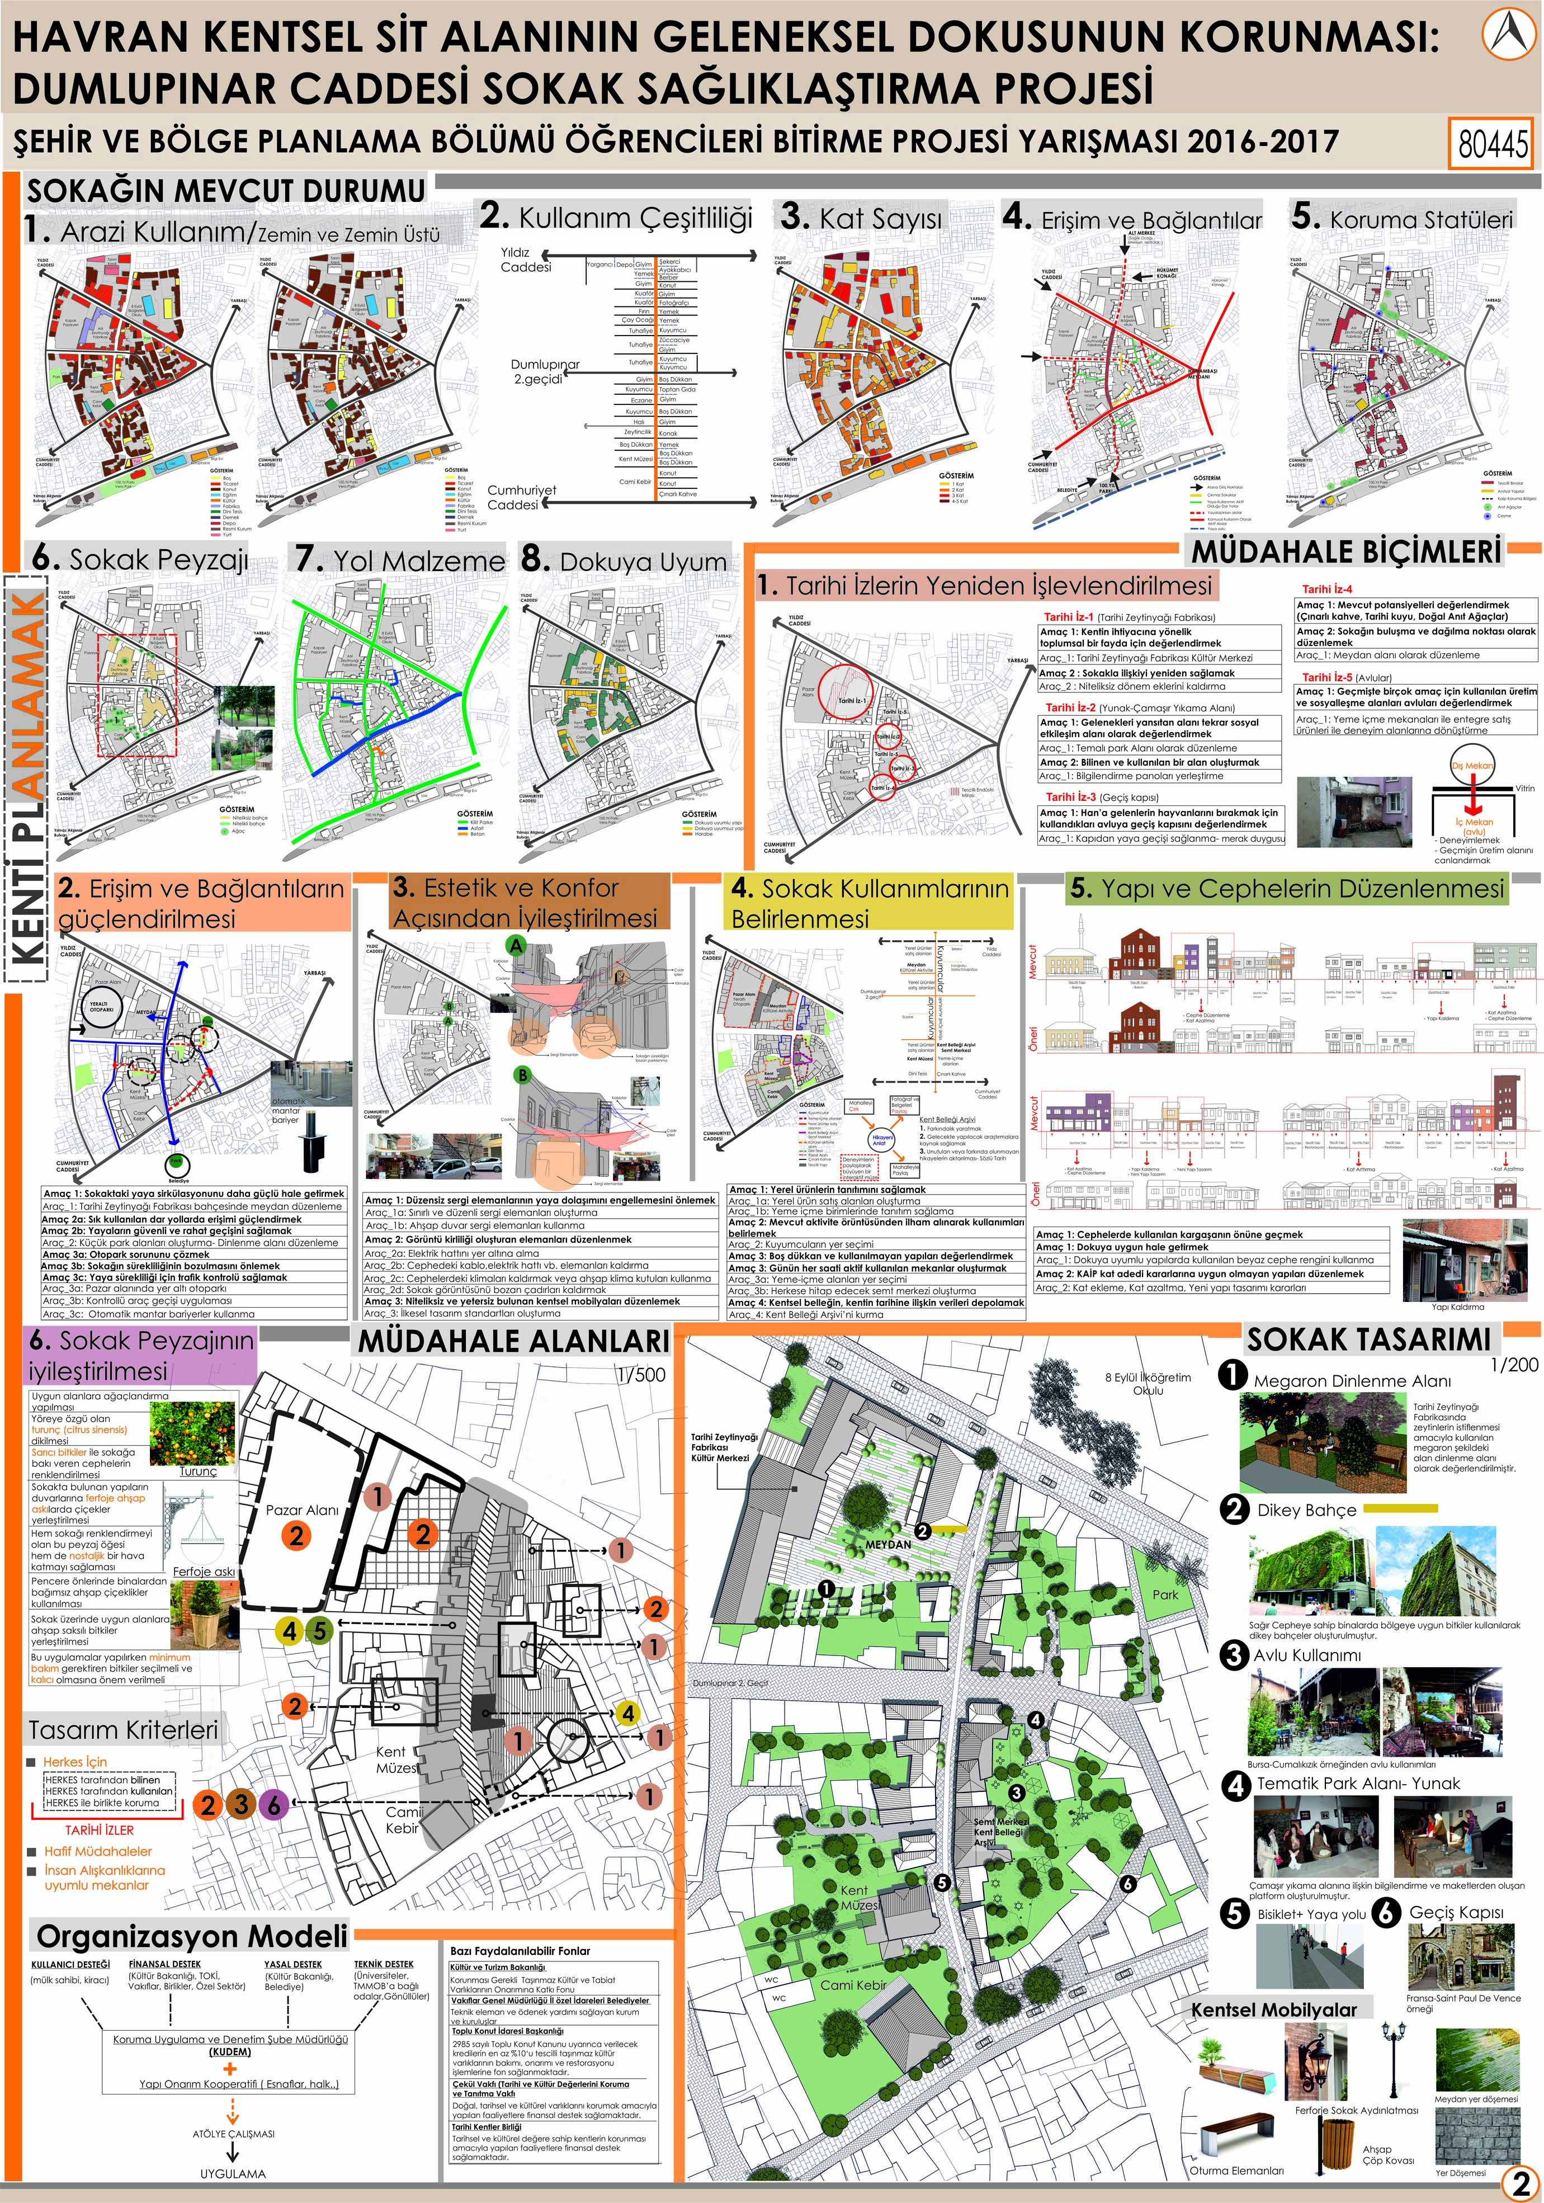
СОХРАНЕНИЕ АРХИТЕКТУРНОГО НАСЛЕДИЯ В ТУРЦИИ ARCHITECTURAL HERITAGE CONSERVATION IN TURKEY TÜRKİYE’DE MİMARİ MİRASI KORUMA ÇALIŞMALARI
STREET REHABILITATION PROJECT

Slide 18
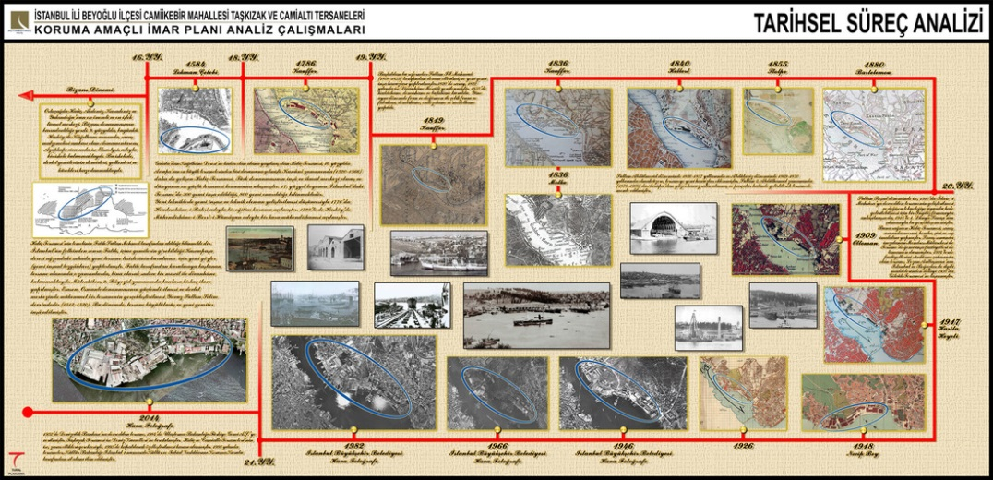
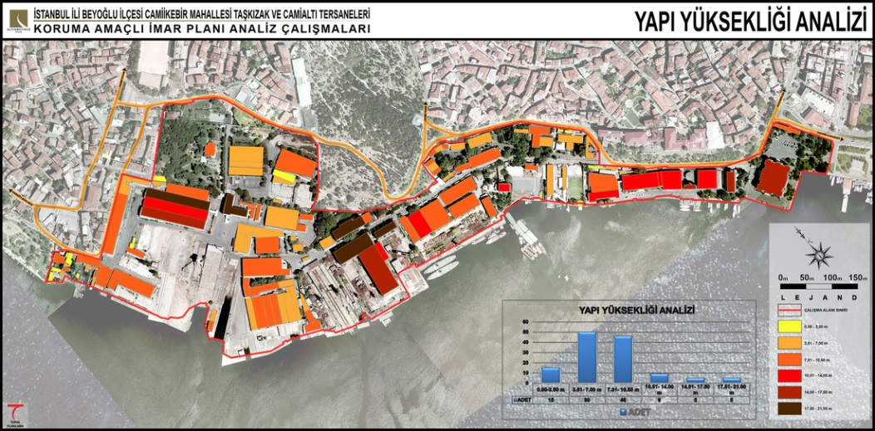
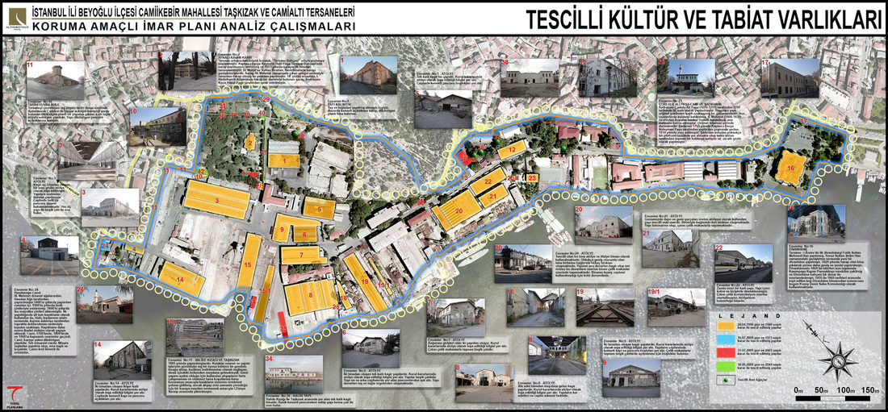
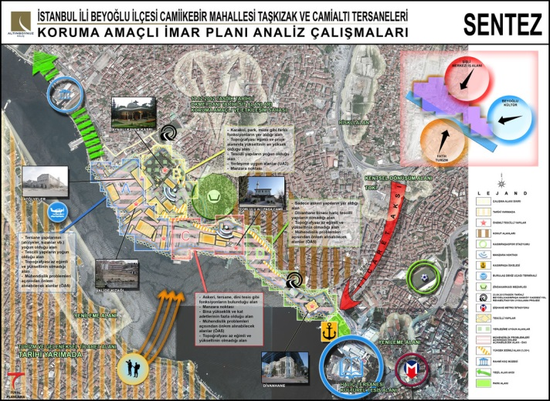
СОХРАНЕНИЕ АРХИТЕКТУРНОГО НАСЛЕДИЯ В ТУРЦИИ ARCHITECTURAL HERITAGE CONSERVATION IN TURKEY TÜRKİYE’DE MİMARİ MİRASI KORUMA ÇALIŞMALARI
CONSERVATION PLAN

Slide 19
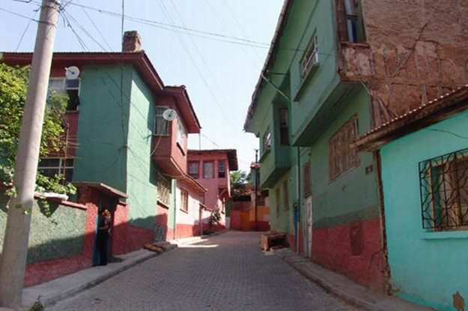
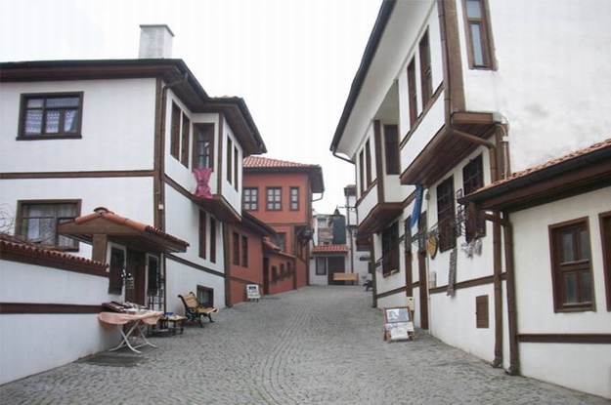
СОХРАНЕНИЕ АРХИТЕКТУРНОГО НАСЛЕДИЯ В ТУРЦИИ ARCHITECTURAL HERITAGE CONSERVATION IN TURKEY TÜRKİYE’DE MİMARİ MİRASI KORUMA ÇALIŞMALARI
STREET REHABILITATION PROJECT
Odunpazarı, Eskişehir

Slide 20
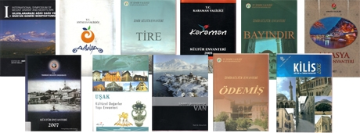
СОХРАНЕНИЕ АРХИТЕКТУРНОГО НАСЛЕДИЯ В ТУРЦИИ ARCHITECTURAL HERITAGE CONSERVATION IN TURKEY TÜRKİYE’DE MİMARİ MİRASI KORUMA ÇALIŞMALARI
INVENTORY

Slide 21
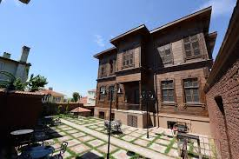
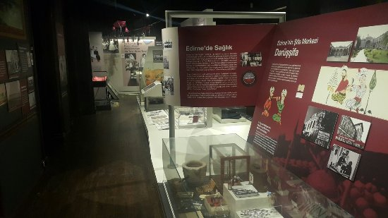
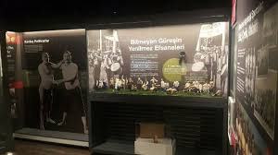
СОХРАНЕНИЕ АРХИТЕКТУРНОГО НАСЛЕДИЯ В ТУРЦИИ ARCHITECTURAL HERITAGE CONSERVATION IN TURKEY TÜRKİYE’DE MİMARİ MİRASI KORUMA ÇALIŞMALARI
CITY MUSEUMS
Edirne

Slide 22
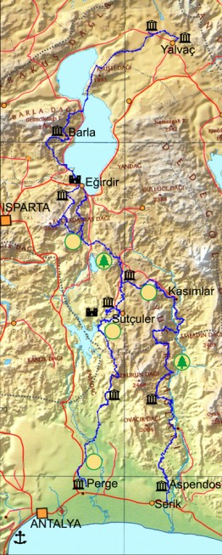
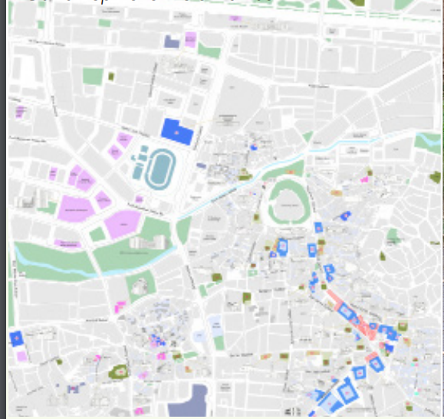
СОХРАНЕНИЕ АРХИТЕКТУРНОГО НАСЛЕДИЯ В ТУРЦИИ ARCHITECTURAL HERITAGE CONSERVATION IN TURKEY TÜRKİYE’DE MİMARİ MİRASI KORUMA ÇALIŞMALARI
CULTURAL ROUTES

Slide 23
СОХРАНЕНИЕ АРХИТЕКТУРНОГО НАСЛЕДИЯ В ТУРЦИИ ARCHITECTURAL HERITAGE CONSERVATION IN TURKEY TÜRKİYE’DE MİMARİ MİRASI KORUMA ÇALIŞMALARI
БЛАГОДАРНОСТЬ
THANKS
TEŞEKKÜRLER

